Slide 1



COMSOL FEM Breast Model for Early Warning Scan
Parametric model-development pipeline for biomechanical breast screening research
Daan Kuijpers | Internship project | Catharina Hospital / TU/e | June 2026
COMSOL FEM Breast Model for Early Warning Scan
1

Slide 2

Why Breast Cancer Screening Still Needs Improvement
Early detection matters, but current screening does not serve every patient group equally well.
- Breast cancer remains one of the most common cancers in women.
- Screening aims to detect disease before symptoms become clinically visible.
- Performance and patient burden depend strongly on the screening modality.
- This motivates complementary, non-invasive measurement concepts.
COMSOL FEM Breast Model for Early Warning Scan
COMSOL FEM Breast Model for Early Warning Scan
2

Slide 3
Limitations of Mammography
Mammography is clinically established, but it has practical and biological limitations.
- Uses ionizing radiation, so screening frequency and age range are constrained.
- Requires breast compression, which can be uncomfortable.
- Dense breast tissue can reduce contrast and sensitivity.
- Younger women are often not included in routine screening programs.
COMSOL FEM Breast Model for Early Warning Scan
3

Slide 4
Early Warning Scan Concept
EWS studies the breast as a moving biomechanical system rather than a static X-ray image.
- Markerless optical system with cameras and projectors around the patient.
- Measures breast surface shape and motion without radiation or compression.
- Designed to detect biomechanical differences caused by internal tissue changes.
- FEM is used to understand which internal changes could be visible at the surface.
COMSOL FEM Breast Model for Early Warning Scan
4

Slide 5
Core Hypothesis
A stiffer internal lesion may alter the dynamic surface response of the breast.
Internal lesion
Local stiffness contrast
Changed displacement / stress field
Measurable surface motion
to
to
to
Model output: displacement, stress and surface-motion metrics over time.
COMSOL FEM Breast Model for Early Warning Scan
5

Slide 6
Where My Project Fits
My work contributes the synthetic FEM-data route before motion quantification and AI can be evaluated.
- WP3: create controlled synthetic FEM cases.
- Bridge to WP4: surface-motion features and AI input.
- Translate anatomy and material choices into reproducible COMSOL runs.
- Quantify which model components affect displacement and stress.
COMSOL FEM Breast Model for Early Warning Scan
6

Slide 7
Project Goal
Build a defensible parametric COMSOL pipeline, not yet a patient-specific detector.
- Parametrize chestwall geometry, glandular structure, asymmetry, support, skin and tumor masks.
- Use a controlled dynamic excitation to compare model variants.
- Separate report-ready baselines from diagnostic sensitivity tests.
- Prepare the model for later patient-specific geometry and EWS-data coupling.
COMSOL FEM Breast Model for Early Warning Scan
7

Slide 8
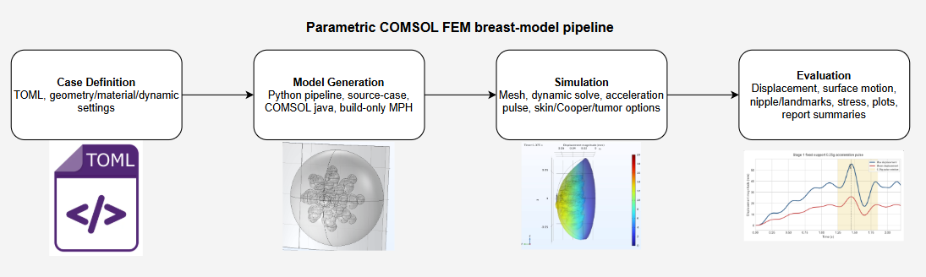
Automated COMSOL Pipeline
Each case is defined by a TOML file and generated into a reproducible COMSOL model.
COMSOL FEM Breast Model for Early Warning Scan
8

Slide 9
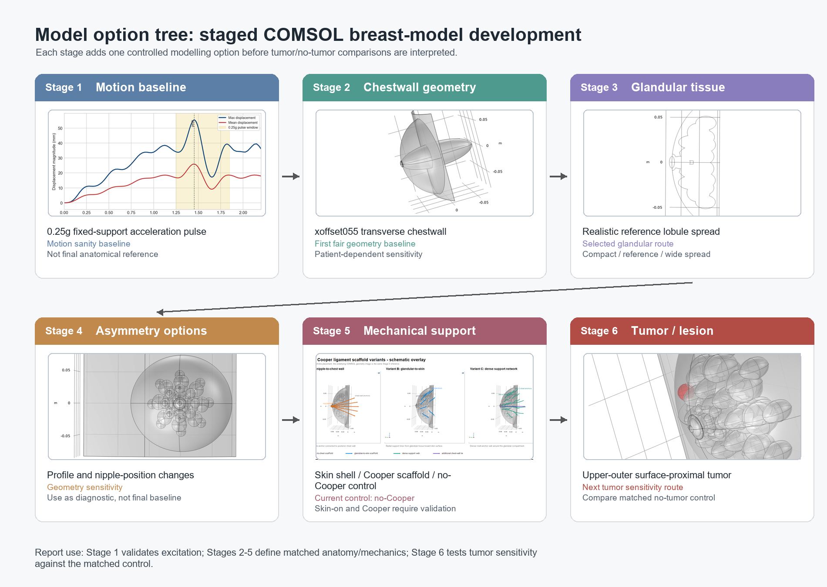
Controlled Model-Development Route
The stages isolate one modelling decision at a time.
COMSOL FEM Breast Model for Early Warning Scan
9

Slide 10
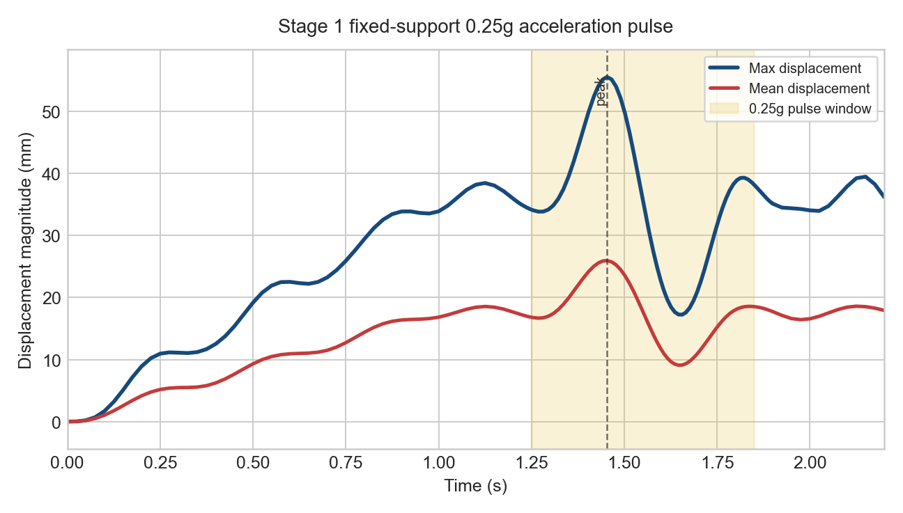
Stage 1: Dynamic Motion Baseline
Stage 1 validates the fixed-support acceleration pulse before anatomical complexity is added.
- 0.25g fixed-support pulse over 0.60 s.
- Useful as a motion sanity baseline.
- Not a fair anatomical comparator to later volume-preserving stages.
- Large displacement in Stage 1 mainly reflects the simpler geometry and larger breast volume.
COMSOL FEM Breast Model for Early Warning Scan
10

Slide 11
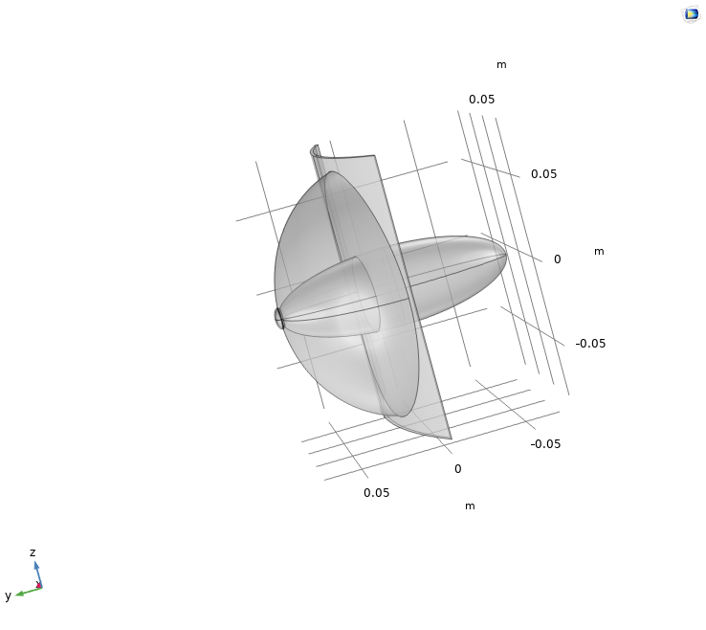
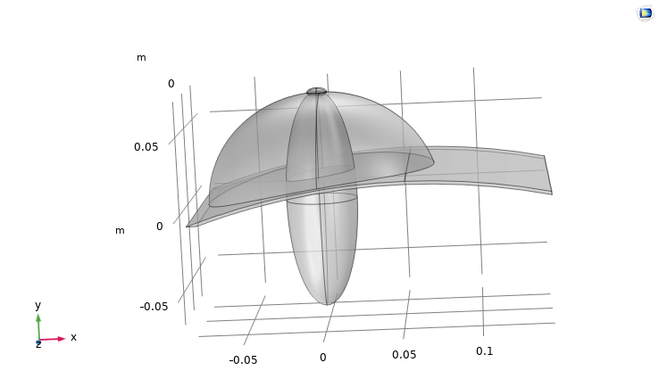
Stage 2: Chestwall Geometry
The selected xoffset055 chestwall creates the first fair anatomical baseline.
- Transverse chestwall curvature with volume preservation.
- Nipple and glandular positions are auto-aligned.
- Chestwall curvature is treated as patient-dependent sensitivity.
- This stage becomes the anatomical base for later variants.
Lateral view
Superior view
COMSOL FEM Breast Model for Early Warning Scan
11

Slide 12
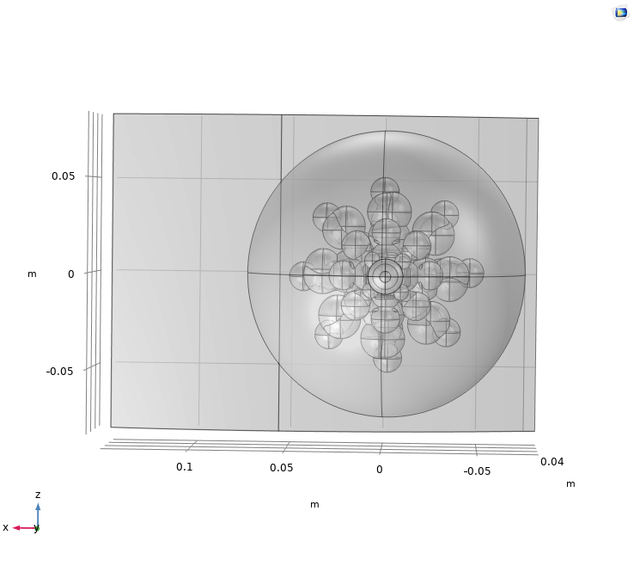
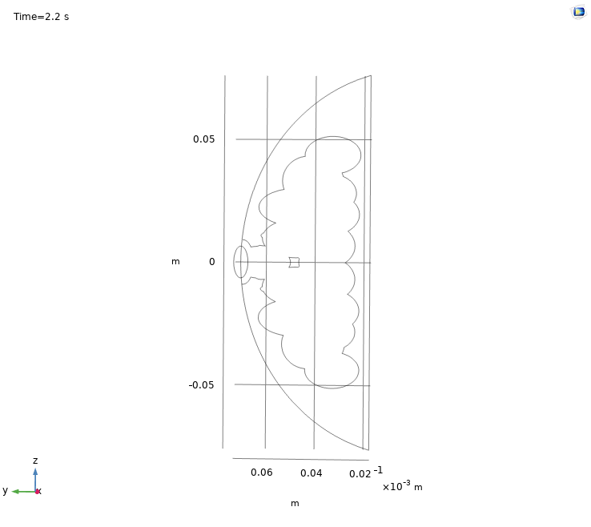
Stage 3: Realistic Glandular Distribution
The glandular region is represented as a chestwall-aware lobule spread.
- Reference glandular fraction is approximately 24.3%.
- More anatomically meaningful than a simple fraction sweep.
- Compact/reference/wide variants can test spatial distribution.
- The reference case continues into Stage 4 and Stage 5 controls.
Reference glandular spread
Sagittal slice
COMSOL FEM Breast Model for Early Warning Scan
12

Slide 13
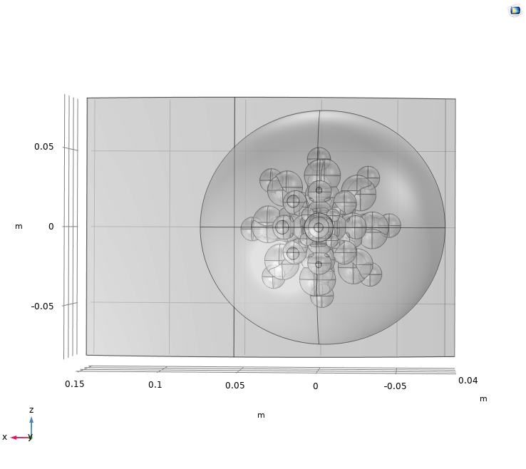
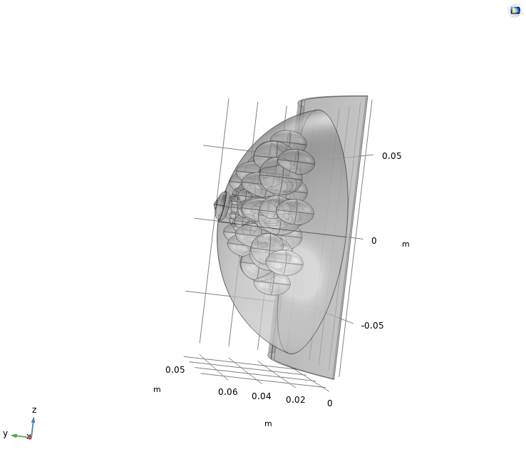
Stage 4: Asymmetry and Nipple Sensitivity
Stage 4 provides a framework for profile and landmark sensitivity.
- Reference case remains a no-asymmetry control.
- Profile asymmetry and nipple-shift variants are geometry-tested.
- Current quantitative results are diagnostic rather than final.
- Useful for later patient-specific shape variation.
Profile sensitivity
Nipple-shift sensitivity
COMSOL FEM Breast Model for Early Warning Scan
13

Slide 14
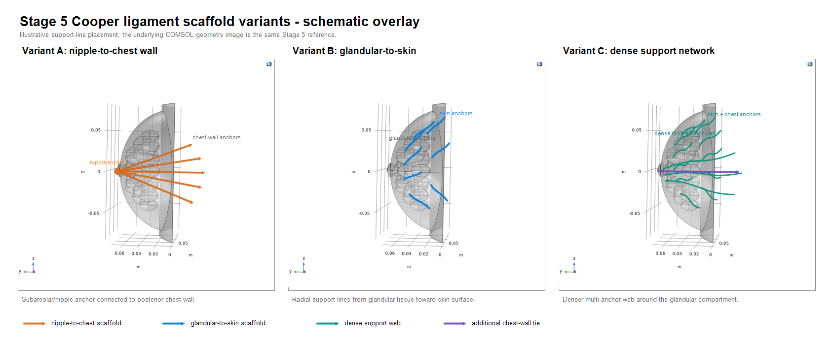
Stage 5: Support and Skin Development
Support and skin dominate the realism of the dynamic response.
- No-Cooper case is the current stable control.
- Cooper-ligament scaffolds are implemented but not yet robust enough for final solves.
- Shell/scaffold skin caused unrealistic surface buckling.
- Volumetric skin is the preferred route for further calibration.
COMSOL FEM Breast Model for Early Warning Scan
14

Slide 15
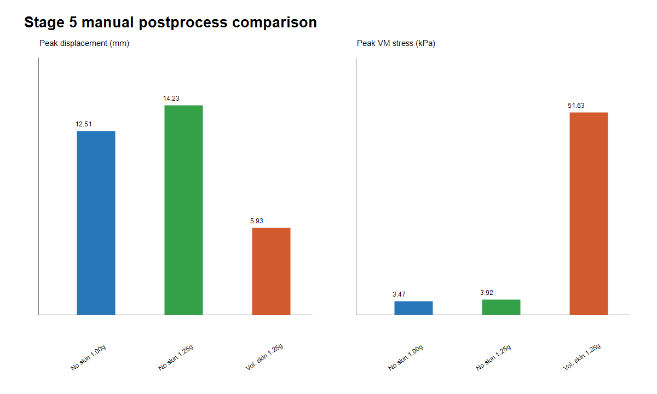
Stage 5 Scout Results
The volumetric skin improves anatomy but strongly damps displacement amplitude.
- No-skin 1.25g: higher peak displacement.
- Volumetric skin 1.25g: lower displacement but visually stable motion.
- Stress hotspots occur mainly near chestwall/support interfaces.
- Soft-interior volumetric skin is the next calibration scout.
COMSOL FEM Breast Model for Early Warning Scan
15

Slide 16
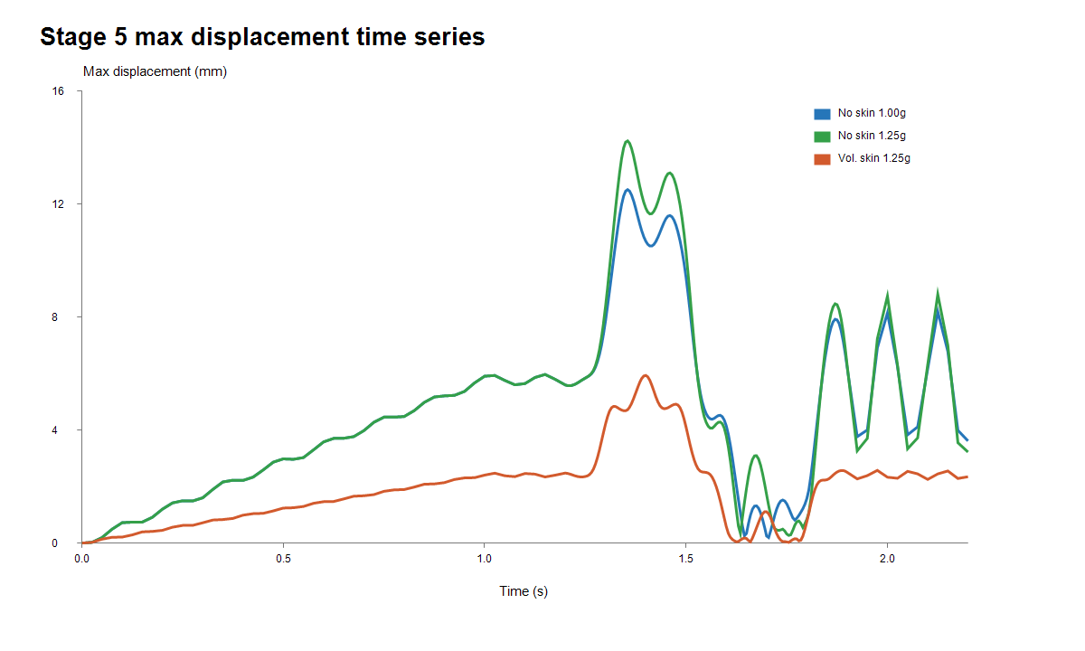
Stage 5 Motion Comparison
The motion pattern is comparable, but the skin layer changes the amplitude.
- Manual Derived Values were used as a reliable fallback for solve-only scouts.
- Peak-time and time-series metrics are sufficient for amplitude screening.
- Animations are useful for visual QA but should not replace quantitative metrics.
- Automated postprocessing is still being debugged for heavy result files.
COMSOL FEM Breast Model for Early Warning Scan
16

Slide 17
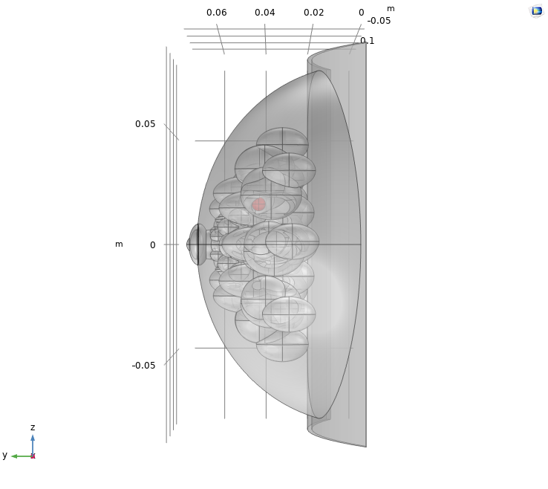
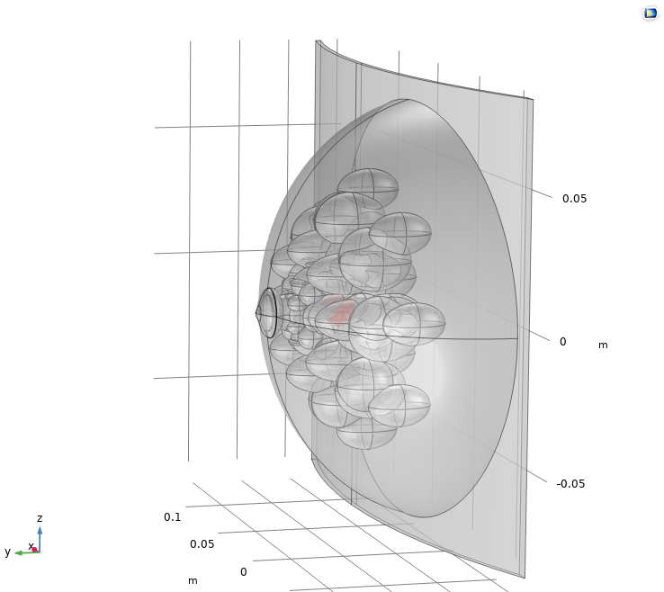
Stage 6: Tumor Implementation
Stage 6 introduces tumors as controlled stiffness-mask sensitivities.
- Analytic spherical tumor mask inside the breast volume.
- Not a separate clinical segmentation yet.
- Variants test size, position and stiffness.
- Upper-outer and surface-proximal locations are prioritized for future solves.
Upper-outer candidate
Medium central candidate
COMSOL FEM Breast Model for Early Warning Scan
17

Slide 18
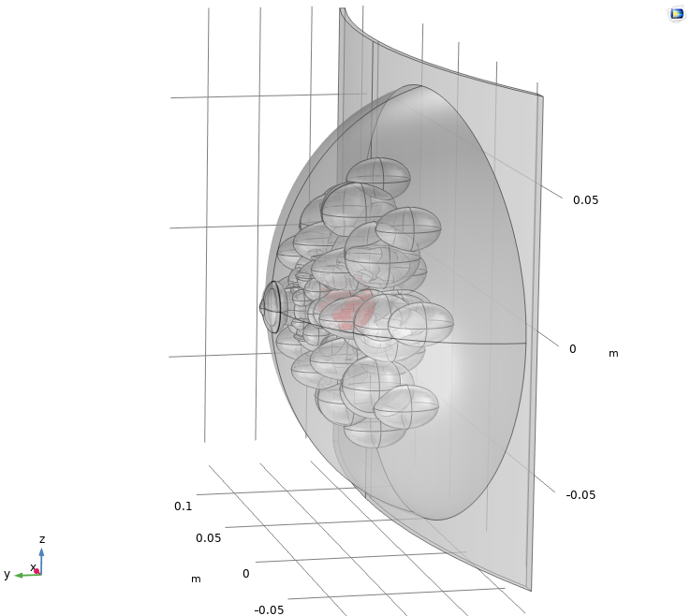
Pending Full Model Comparison
The next quantitative result should be a matched no-tumor versus tumor comparison on the chosen baseline.
- First choose the final Stage 5 baseline: volumetric skin with calibrated interior stiffness.
- Then run matched control and tumor cases with identical geometry and excitation.
- Evaluate surface displacement, nipple/landmark displacement and stress around the lesion.
- Avoid running many tumor cases before the baseline amplitude is credible.
COMSOL FEM Breast Model for Early Warning Scan
18

Slide 19
Current Limitations
The model is a controlled research pipeline, not a clinical patient-specific model yet.
- Geometry is parametric rather than patient-specific.
- Dynamic input is an excitation model, not a validated real jump reproduction.
- Material stiffness and damping still need calibration.
- Cooper support and tumor effects require robust matched solves.
- Automated postprocess is still under improvement for large MPH files.
COMSOL FEM Breast Model for Early Warning Scan
19

Slide 20
Main Conclusion
The project establishes a reproducible COMSOL route for controlled EWS model development.
- A staged anatomical baseline is available.
- Dynamic excitation, skin and material choices are now the key calibration issues.
- Tumor placement is geometry-ready for matched sensitivity runs.
- The pipeline can support future patient-specific geometry and EWS-data coupling.
COMSOL FEM Breast Model for Early Warning Scan
20

Slide 21
Next Steps
The highest-value next work is calibration before broad tumor sweeps.
- Run and evaluate soft-interior volumetric-skin scout.
- Select primary dynamic excitation amplitude.
- Run matched no-tumor versus upper-outer tumor cases.
- Improve surface/landmark postprocess reliability.
- Extend later toward patient-specific anatomy and real EWS measurements.
COMSOL FEM Breast Model for Early Warning Scan
21

Slide 22
Questions
Thank you
COMSOL FEM Breast Model for Early Warning Scan
22

